Slide 1
Topic Based Zoom: Salary Cap/MCOP Worksheet Critical Concepts 3/16/22
Notes:
Today’s Topic Based Zoom is Salary Cap/MCOP Worksheet Critical Concepts. We will be going over critical concepts to remember when using the Salary Cap/MCOP Worksheet.
This presentation is being recorded and will be posted on our Review and Reinforcement page.
If you have questions about the presentation please put them in the chat and we will get to them during the Q&A. We actually have our UCPath Finance SME here with us today so it’s going to be a great day!

Slide 2







Today’s Topics
Resource Review
Salary Cap/MCOP Worksheet Critical Concepts
Reminders and Key Takeaways
Best Practices and Q&A
Notes:
First we will quickly review resources
Next we will go over the Salary Cap/MCOP Worksheet Critical Concepts
Then review some reminders and Key Takeawys
And finally end with best practices and Q&A.

Slide 3
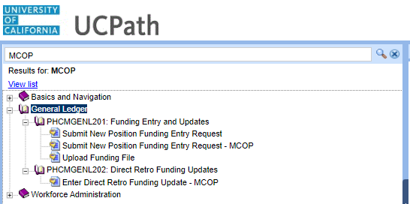
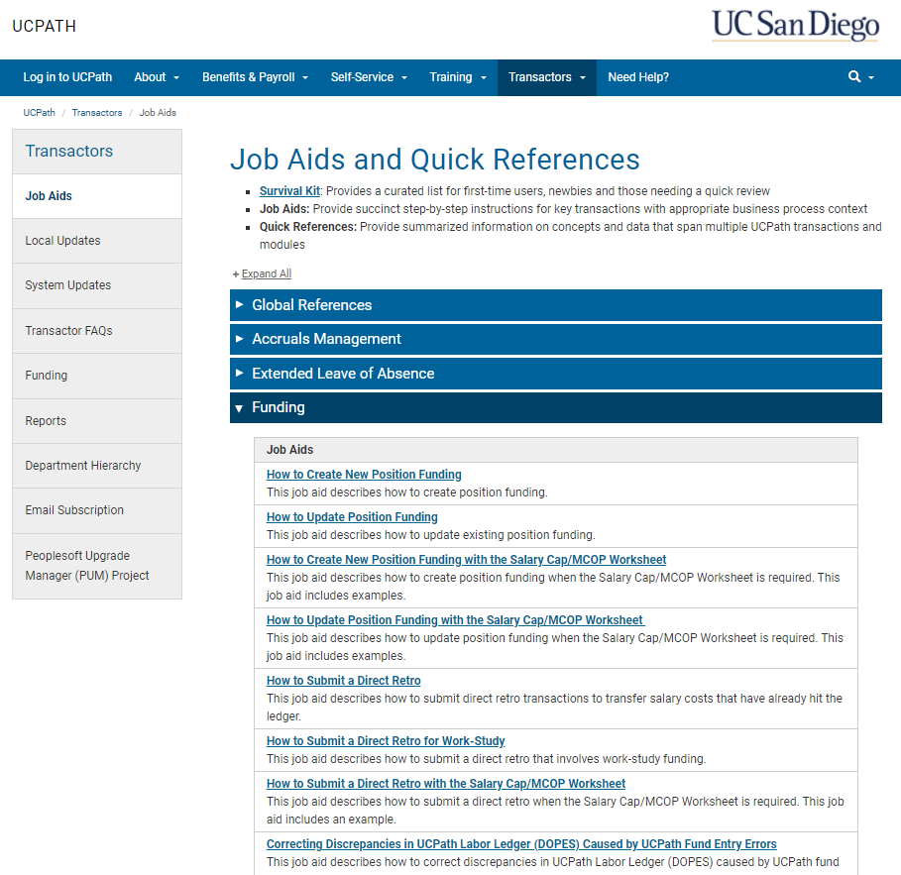
Resource Review
UC San Diego - UCPath Job Aids and Quick References Page
UCPath Transactor Help Site
For assistance completing a transaction schedule a 1:1 Appointment
For assistance troubleshooting or to report an issue submit a SNOW ticket to the UCPath-Finance team
For general questions about UCPath attend the UCPath Office Hours
Notes:
Before starting a transaction in UCPath you should review the Job Aids. Using the Salary/MCOP worksheet can be complicated and it is important to not skip a step. You can find step by step instructions on the UC San Diego –UCPath Job Aids and Quick References Page and the UCPath Transactor Help Site.
There are also 1:1 appointments that can be scheduled to enter a transaction together with someone on the UCPath Finance team. Or a SNOW ticket can be submitted to the UCPath-Finance team if you need immediate assistance. If you have general questions about the UCPath Job Aid steps you can also attend the UCPath Office Hours.
Knowledge Based Articles

Slide 4
Funding Pages Navigation
Direct Retro Process direct retro / salary cost transfer transaction | PeopleSoft Menu > Payroll for North America > Payroll Distribution > UC Customizations > Process Direct Retro
Funding Entry Inquiry View funding information for positions | PeopleSoft Menu > Set Up HCM > Product Related > Commitment Accounting > UC Customizations > Funding Entry Inquiry
Funding Entry Setup or update funding for positions | PeopleSoft Menu > Set Up HCM > Product Related > Commitment Accounting > UC Customizations > Funding Entry
Review Direct Retro View existing direct retro transactions | PeopleSoft Menu > Payroll for North America > Payroll Distribution > UC Customizations > Review Retro Distribution
Notes:
Here is a list of the navigation to key Funding Entry pages in UCPath.

Slide 5


Salary Cap/MCOP Worksheet Critical Concepts
Funding Entry
Direct Retro
Notes:
And now lets move on to the Salary Cap/MCOP worksheet critical concepts!
We will go over the critical concepts to remember regarding the Salary MCOP Worksheet on Funding Entry Page and on the Direct Retro Page

Slide 6

6
Salary Cap/MCOP Worksheet Scenarios
There are three scenarios that require the Worksheet.
Regular pay is composed of multiple components of pay (GCCP, HSCP)
Pay is funded by one or more capped funds
Regular pay is composed of multiple components of pay and funded by one or more capped funds
1
2
3
Notes:
There are three situations in which you must use the Salary Cap/MCOP Funding Worksheet.
The first is for any position that has regular compensation composed of multiple components of pay. This, primarily, means for the General Campus Compensation Plan and for the Health Science Compensation Plan. The reason for this, is the Worksheet is integrated with the Earnings Distribution section of Job Data. When HR initiators adjust the dollar amounts of pay in Job Data, those updates will cascade to the funding, as long as the Worksheet has been used to set up the funding. If you have not used the Worksheet, there is no integration.
The second time you must use the Worksheet is for any position whose funding includes capped funds. Capped funds are those like NIH and CIRM funds. The Worksheet is the only place in UCPath where the capped funding information populates and the rules associated with those funds have been configured. This includes information like the salary cap and the over-the-cap indicator.
The third is when both are happening.

Slide 7
Funding with the Worksheet | Key System Steps
1
2
3
4
5
Navigate to the Funding Entry page; Add a New Value tab
Enter the appropriate Set ID, Department, Fiscal Year and Position Number
Click Salary Cap/MCOP Funding Worksheet
Create/adjust Default Funding Profile if needed
Enter Funding Distribution Worksheet details
6
7
8
9
10
Review Funding Distribution Preview; allocate OTC costs
Review FAU Monthly Preview
Click Submit to Funding Entry
Attach supporting documents, enter comments and
click Save
Submit for review and approval
Notes:
Let’s quickly review the key system steps for completing a funding entry transaction using the Worksheet.
First, you’ll navigate to the Funding Entry page and select the Add a New Value tab. On the Add a New Value tab, Set ID should default correctly. Then you’ll enter the Department Code, Position Number, and check the default Fiscal Year. Remember, you need the Fiscal Year on this screen to include the date for the Funding Entry transaction you’re going to submit. Then click Add.
Once on the Funding Entry screen for the position, you’ll click the link for the Salary Cap/MCOP Worksheet.
The first thing you will do on the Worksheet is create the Default Funding Profile. If you are making an update and the Default Funding Profile is already set up, you may not need to adjust.
Then, you’ll enter the Funding Distribution Worksheet details. This means entering Begin and End Dates, Earn Codes, Chartstrings and Distribution percentages for all up-to-the-cap salary costs.
Then you will review the Funding Distribution Preview and allocate any over-the-cap salary costs. If you’d like, you can then review the FAU Monthly Preview. Once you are satisfied that your entries are correct, you will click Submit to Funding Entry.
The data will then be sent over to the Funding Entry page. You can attach documents, enter comments for your approver and click save. Once you have saved you can click submit and the transaction will route for local approval.

Slide 8
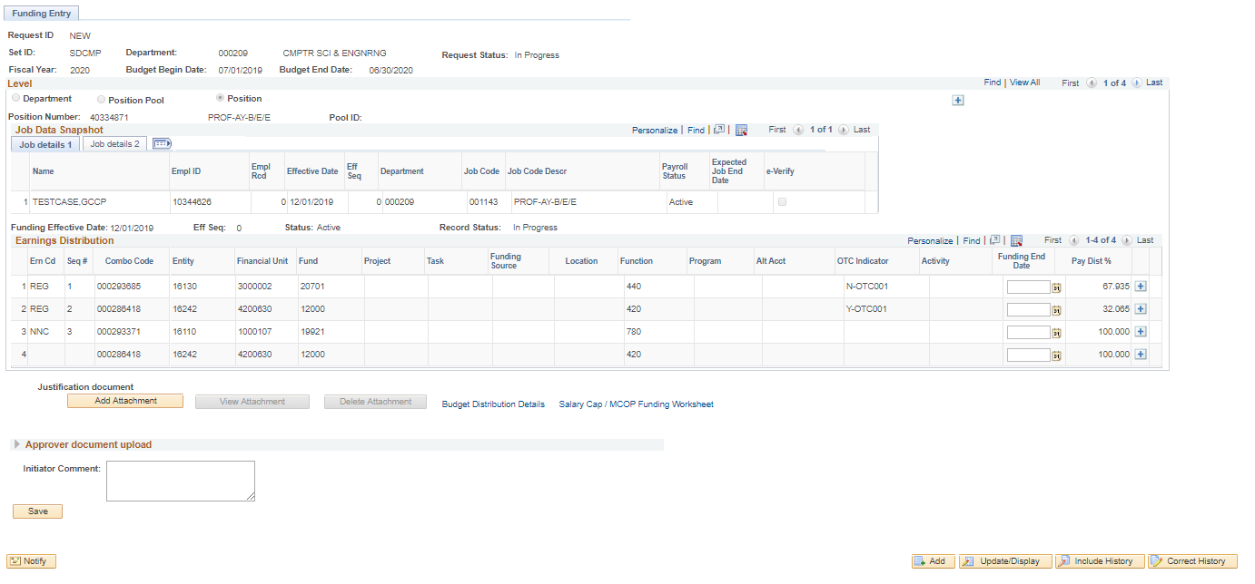
Funding Entry Page
The employee’s job details are displayed in Job Data Snapshot. When a position is vacant there will be no data. The Job details 2 tab contains links to the Job Earnings Distribution and Additional Pay for review.
Review the effective dated funding entries. The latest effective dated row will be on top. You can click View All to see them all on the page.
Use the Funding End Date field if the fund source has a date in which it will no longer be effective, or leave blank.
The sum of the distribution percent across the funding lines = 100% per Earn Code
Salary Cap/MCOP Worksheet link only visible for filled positions
Do not click “Add” before submitting – it returns you to the Add a Value page
Notes:
Let’s review the important things to remember on the Funding Entry page when using the Salary Cap/MCOP worksheet.
The employee’s job details are displayed in Job Data Snapshot. When a position is vacant this will be blank. The Job details 2 tab contains links to the Job Earnings Distribution and Additional Pay for review.
If there are multiple Effective Dates. You will want to review your effective dated funding entries. The latest effective dated row will be on top. If you click back using the forward and back buttons at the top of the page, you can see the previous effective-dated funding distribution. Or you can click View All to see them all on the page.
You can also add Funding End Dates, if needed.
Also notice that the sum of the distribution percent across the funding lines on this screen is 100% per EARN CODE
And Remember the Salary Cap/MCOP worksheet link only appears for filled positions
After you have filled out the Salary Cap/MCOP worksheet you will return to this page and enter any comments required for your approver, then click Save and Submit. The Submit button will appear after you click Save and the system checks for errors. The transaction will not be routed for approval until the Submit Button is pressed. You will notice that the Request Status says In Progress if the transaction was only Saved not Submitted.

Slide 9
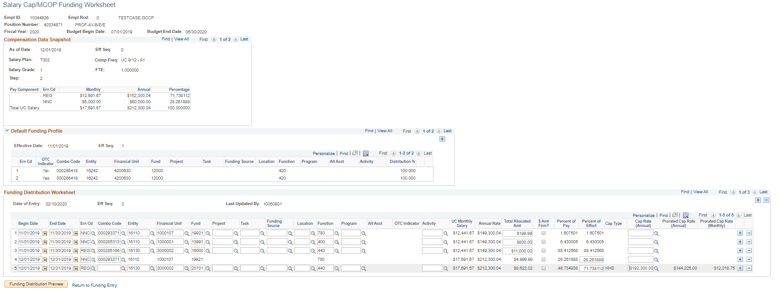
Salary Cap/MCOP Funding Worksheet
Compensation Data Snapshot shows the pay associated with the position. Contact your HR Initiator in order to make changes or adjustments to the Compensation Data.
It is recommended to enter the Percent of Effort and let the system calculate Percent of Pay and Total Allocated Amt.
Default Funding Profile is where Blank Earn Code funding is set up for up-to and over-the-cap funding. The Distribution Percentage must sum to 100% for each Earn Code and OTC Indicator combination.
The capped fund line can account for the full REG Percent of Effort, but is configured not to fund the over-the-cap-amount (cap-gap). This is why the Percent of Pay and Total Allocated Amt may not “match” the Percent of Effort on a capped funding line (e.g., NIH, etc.).
You will get an error message if Total Allocated Amt, Percent of Pay, or Percent of Effort exceed 100% for the Earn Code and Begin/End Date.
The Begin Date identifies when the funding will go into effect. If there are multiple Begin Dates then UCPath will create multiple Effective Dates to ensure that only the funding that is in effect at that time is used.
The system defaults the Cap Type and the Cap Rate (Annual) values from the Type of Fund. You can use the look up button to see a list of Cap Rate options. The Cap Rate should be the rate that is in effect at the time of the effective period.
Click the Funding Distribution Preview button to review the funding and fund the over-the-cap amount.
Notes:
Now let’s review the important things to consider on the Salary Cap/MCOP Funding Worksheet.
The Compensation Data Snapshot shows the pay associated with the position. The Funding initiator cannot make any changes to an employee’s compensation. Contact your HR initiator in order to make changes or adjustments to the Compensation Data through a PayPath update.
Use the Default Funding Profile to set standard over-the-cap and up-to-the-cap catchall fund sources. It is really just two blank earn code rows, one for the up-to-the-cap earnings and one for the over-the-cap earnings. If part of the employee's total UC salary is not fully allocated, the system uses the appropriate Catch-All row. The Distribution Percentage must sum to 100% for each Earn Code and OTC Indicator combination. For example, if you have two rows for the catch-all with an OTC Indicator of No, then the sum of those two rows would need to equal 100%.
The use of sponsored Funds is NOT allowed in the Default Funding Profile. No sponsored Funds can be used for Over-the-Cap (cap gap) in UCPath, even if allowed by the private agency/award.
Let’s move down to the Funding Distribution Worksheet section.
On the Funding Distribution Worksheet you can use the plus and minus buttons within the worksheet rows to add and delete rows as needed. The Worksheet uses begin and end dates instead of effective dates. The Begin Date identifies when the funding will go into effect. If there are multiple Begin Dates then UCPath will create multiple Effective Dates on the Funding Entry page to ensure that only the funding that is in effect at that time is used.
On the Worksheet, the sum of all funding lines will equal 100% per begin and end date combination.
You can enter a value in only one of the following fields: Total Allocated Amount, Percent of Pay or Percent of Effort. The system derives the value of the other two fields and those fields are not editable. You can delete the value in the field for which you entered a value to prompt the system to make the other fields editable again. It is recommended to enter the Percent of Effort and let the system calculate Percent of Pay and Total Allocated Amt.
If you are entering a capped fund, the system defaults the Cap Type and the Cap Rate (Annual) values from the Type of Fund. You can use the look up button to see a list of Cap Rate options. The Cap Rate should be the rate that is in effect at the time of the effective period.
Click the Funding Distribution Preview button to review the funding and fund the over-the-cap amount. The OTC amount is calculated by the system, you only need to enter the funding.

Slide 10
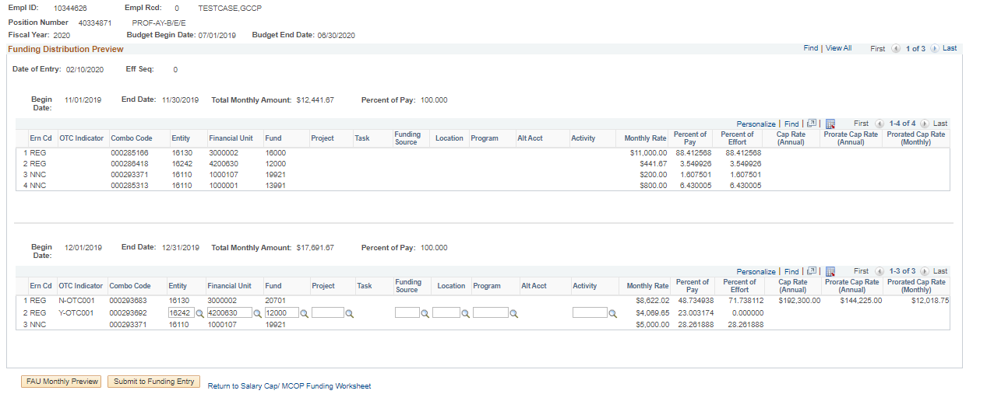
Funding Distribution Preview
Funding distributions are broken down by each differently funded pay period from the Salary Cap / MCOP Funding Worksheet.
The Percent of Pay and Monthly Rate that are unaccounted for on the Worksheet are added on a new distribution line, using the over-the-cap default funding source from the Default Funding Profile. You can choose to change the chartstring (funding source) for this line here.
The Percent of Pay and Percent of Effort should total to 100% on the Worksheet.
Click to transfer data to the Earnings Distribution section of the Funding Entry page.
The OTC Indicator value identifies whether a distribution line is the up-to-the-cap row or an over-the-cap-row:
Uncapped rows do not have an OTC Indicator (field is blank)
An OTC Indicator starting with N is the up-to-the-cap row
An OTC Indicator starting with Y is the over-the-cap row
An OTC value with –OTCXXX at the end links the OTC row to the capped funding source line that is responsible for the OTC funding line
Notes:
Now let’s review the Funding Distribution Preview page. The Funding Distribution Preview display all funding for the fiscal year broken down by unique funding distributions. This is also the only screen where the OTC Indicator field is visible and where over-the-cap funding rows will be inserted.
Funding distributions are broken down by each differently funded pay period from the Salary Cap / MCOP Funding Worksheet.
The Percent of Pay and Monthly Rate that are unaccounted for on the Worksheet are added on a new distribution line, using the over-the-cap default funding source from the Default Funding Profile. You can choose to change the funding source by editing the chartstring for this line here. BUT there is currently a defect that does not allow you to delete the combo code and so you will not be able to override the chartstring. If you need to update the chartstring to something different than what is in the Default Funding Profile, you will need to do a Direct Retro after payroll to move the OTC.
The Percent of Pay and Percent of Effort should total to 100% on the Worksheet.
If any EARN CODE is not fully funded, the default funding source from the Default Funding Profile will be used to insert a row for the unfunded amount. If there were unaccounted for earnings for under the salary cap on a distribution line, the Worksheet will insert a row using the up-to-the-cap funding source. If there were unaccounted for earnings that exceeded a salary cap on a distribution line, the Worksheet will insert a row using the over-the-cap funding source.
Note that not all funding sources can be used for over-the-cap distribution lines. UCPath has built-in edits to enforce policy related to over-the-cap earnings.
Now let’s talk about the OTC Indicator field.
OTC stands for over-the-cap. The OTC Indicator displays on the Funding Distribution Preview, where there are over-the-cap costs being funded. Rows that have uncapped funding sources will not display any information in the OTC Indicator field. It will be blank.
You can see that both of the REG rows have a value in the OTC Indicator field. In the first REG row, the OTC Indicator has an N value. That means this is the up-to-the-cap row. This is funding for an amount that is not over-the-cap. The second REG row has a Y value in the OTC indicator field. That means that this row is funding the over-the-cap amount of salary. Now look at the number at then end of the indicator. Both of these indicators have the number one at the end. That means these rows are paired. The Y row is funding the over-the-cap-amount from the N row.
The Combo Codes generated in the worksheet are specific to the worksheet since the OTC indicators are included in the combination. The Combo Codes generated in the worksheet cannot be used anywhere else.
If, in your review, you discovered something was incorrect, you would click the Return to the Salary Cap/MCOP Worksheet link to return to the worksheet to make your changes and then regenerate the preview. If everything looks good, you can click the FAU Monthly Review button to generate an Excel spreadsheet that will display the monthly distribution amounts by fund across the fiscal year. Be sure to turn off your Popup Blocker, otherwise the Excel file with the FAU Monthly Preview will not download and open.
After reviewing the FAU Monthly Preview, go back to your UCPath screen and click the Submit to Funding Entry button. This button sends your Worksheet data to the Funding Entry screen where you will then save and submit your funding entry.

Slide 11
Direct Retro with the Worksheet | Key System Steps
1
2
3
4
5
Navigate to Process Direct Retro page and click Add a New Value tab
Click Add to display Process Direct Retro Distribution page
Search for appropriate payroll data and select applicable transactions​
Run the process to display Retro Distribution component
Enter New Data using the Direct Retro Salary Cap/MCOP Worksheet
6
7
8
9
10
Review Preview Direct Retro Distribution and enter OTC fund sources
Click Submit to Direct Retro Page
Finish entering New Data and Check Balance
Attach supporting documents, enter comments, choose Reason and
click Save
Submit for review and approval
Notes:
Let’s quickly review the key system steps for completing a Direct Retro transaction using the Worksheet.
The first step is to navigate to the Process Direct Retro page and click the Add a New Value tab.
On the Add a New Value tab, click Add to display the Process Direct Retro Distribution page.
You will use the Process Direct Retro page to request processed payroll data from the system by searching for processed payrolls for a particular employee job record.
Once you identify the data you want to edit, click the Run button. Once the system has fetched the payroll data, it will use it to populate the Retro Distribution page.
On the Retro Distribution page, you will click the Direct Retro Salary Cap/MCOP Worksheet link and use the Worksheet to enter the new funding data.
Then you will review the Preview Direct Retro Distribution and enter funding sources for over-the-cap salary costs.
Next you will click Submit to Direct Retro Page.
You will then finish adding New Data, if applicable, and click Check Balance.
Next you will attach any supporting documents, enter comments, choose the Reason for the direct retro and click Save.
Finally, click submit and the transaction will route for approval.

Slide 12
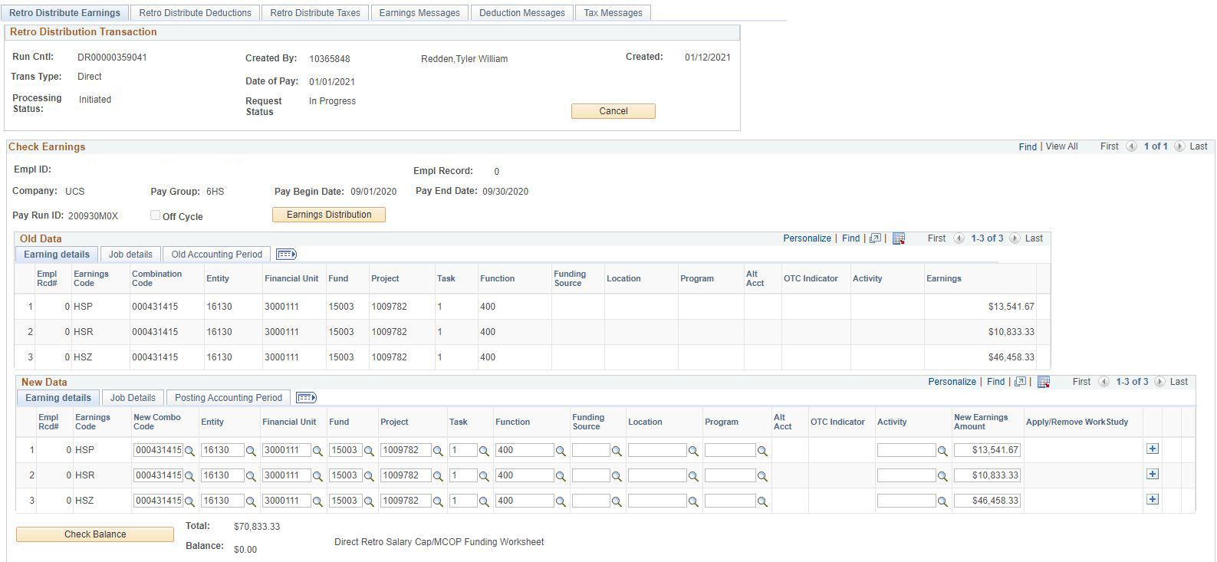
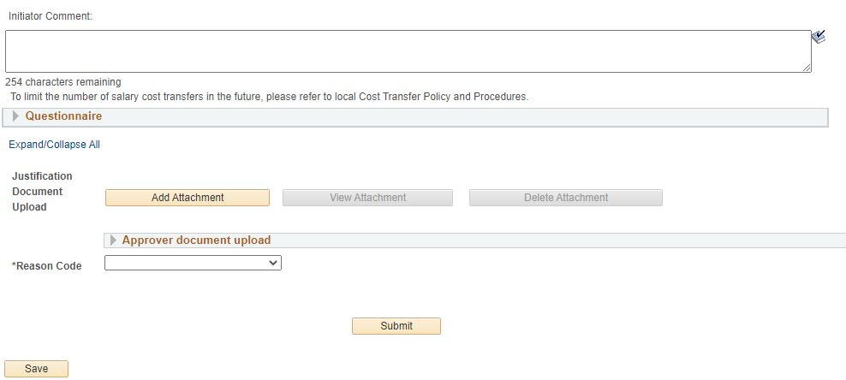
Retro Distribute Earnings Page
After using the Worksheet, click Check Balance to ensure a $0 balance.
The Direct Retro Salary Cap/MCOP Funding Worksheet link activates when you enter a capped fund in the New Data section, and the employee’s total UC salary exceeds the fund’s annual salary cap
Notes:
Let’s review the important things to remember on the Retro Distribute Earnings page when using the Salary Cap/MCOP worksheet.
On the Retro Distribute Earnings page, you will use the New Data section to reallocate employee earnings to different funding sources.
When you enter a capped fund in the New Data section, and the employee’s total UC salary exceeds the fund’s annual salary cap, the Process Direct Retro page activates the Direct Retro Salary Cap/MCOP Worksheet link. The system will also display an error message directing you to use the Worksheet. Click OK on the error message and then click on the ​Direct Retro Salary Cap/MCOP Worksheet link.
After you have filled out the Salary Cap/MCOP worksheet to redistribute funding for earnings that are part of the Total UC Salary, you will return to this page to redistribute funding for other earnings like for stipends.
You will also want to verify all the earnings are properly accounted for and click the Check Balance button to ensure a $0 balance. Once your balance is at zero, you can proceed to entering comments for your approver, attaching supporting documents and answering the Questionnaire. You will only complete the Questionnaire if you are processing a High Risk Direct Retro. That is a direct retro that violates the 120 or 90 day rule.
When you are ready to Save you will select a Reason Code from the dropdown menu. When you click Save, the system will run a check to ensure that the New Data total matches the Old Data Total. You will receive an error message if it doesn’t. You cannot submit a direct retro if the new data and old data totals don’t match.
Once the Submit appears you can click it when you are ready.

Slide 13
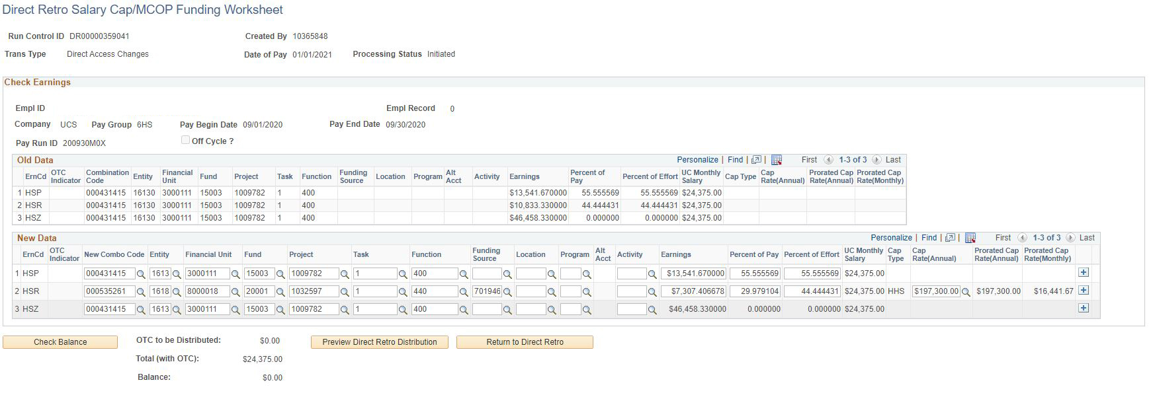
Direct Retro Salary Cap/MCOP Funding Worksheet
When you enter a capped fund, the Cap Type and the Cap Rate (Annual) values are displayed on the Direct Retro Salary Cap/MCOP Funding Worksheet. You can use the look up button to see a list of Cap Rate options. The Cap Rate should be the rate that is in effect at the time of the expense.
After you make the necessary updates, click Preview to see how the system will allocate over the cap (OTC) amounts for new data. You can then update the OTC funding rows that are generated.
Notes:
Now let’s review the important things to consider on the Salary Cap/MCOP Funding Worksheet.
You will use the Direct Retro Salary Cap/MCOP Funding Worksheet to update the funding distribution in New Data. When you enter a capped fund the Cap Type and the Cap Rate values will populate on the worksheet, just as in the Funding Entry module. You can use the look up button to see a list of Cap Rate options. The Cap Rate should be the rate that is in effect at the time of the expense.
After you make the necessary updates, click the Preview Direct Retro Distribution button to see how the system will allocate over the cap (OTC) amounts for new data. You can then update the OTC funding rows that are generated.

Slide 14
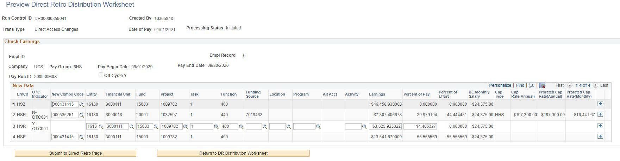
Preview Direct Retro Distribution Page
This page is view-only except for lines where the OTC Indicator begins with the letter Y. These rows must be funded by uncapped funds. You will override or enter the fund data on the Y-OTC row.
The Percent of Pay and Monthly Rate that are unaccounted for on the Worksheet are added on a new distribution line.
After all distributions rows are accurate, click Submit to Direct Retro Page. If the data passes the page funding edits, the system displays the data on the Process Direct Retro page.
If you notice inaccuracies in the funding lines, return to the Direct Retro Salary Cap/MCOP Funding Worksheet to make changes and regenerate the preview.
Notes:
The Preview Direct Retro Distribution page displays a preview of the funding distributions so that you can verify that the data is accurate. It is also the screen when you can enter the funding for the over-the-cap distribution rows.
This page is view-only except for lines where the OTC Indicator begins with the letter Y. These rows must be funded by uncapped funds. You will override or enter the fund data on the Y-OTC row.
Just as in Funding Entry, The Percent of Pay and Monthly Rate that are unaccounted for on the Worksheet are added on a new distribution line in the Preview page.
You’ll want to review the entire distribution preview. If you notice inaccuracies in the funding lines, return to the Direct Retro Salary Cap/MCOP Funding Worksheet to make changes and regenerate the preview.
Once your rows are accurate, click the Submit to Direct Retro Page button. If the data passes the page funding edits, the system displays the data on the Process Direct Retro page.

Slide 15

Reminder
15
Beginning 10/1/21, the use of sponsored Funds is NOT allowed in the Default Funding Profile in Funding Entry and is NOT allowed for the Over-the-Cap in Direct Retro. No sponsored Funds can be used for Over-the-Cap (cap gap) in UCPath, even if allowed by the private agency/award.
If a sponsored Fund was previously entered in the Default Funding Profile, it will remain until there is a change made to the MCOP/salary cap worksheet. At that point, an error message will appear and the Default Funding Profile must be corrected before the funding update can be submitted.
KBA: UCPath Funding FAQs
Notes:
Here is a reminder about sponsored Funds not being allowed to use in the Default Funding Profile in Funding Entry or Over the cap in Direct Retros.
You can find this info in the UCPath Funding FAQs along with other frequently asked questions.

Slide 16

New Job Aid
The salary cap worksheet is not working correctly for BW/hourly positions that are less than 1.0 FTE, where a capped Fund is used, and the employee's hourly rate exceeds the cap rate. Because of this issue, starting 2/7/2022, the link to the salary cap worksheet has been disabled for hourly/BW positions where a capped Fund is used. This means that you will have to calculate the under-the-cap & OTC percentages and enter them into the main Funding Entry page. When the person’s hourly rate changes or the cap rate changes, you will have to change the percentages in Funding Entry accordingly. The removal of the link and the need to calculate the under-the-cap and over-the-cap also applies to direct retros.
Note: this is only necessary when the person’s hourly rate exceeds the annual cap rate/2088 hrs.
Notes:
A new job aid is in the works for steps on how to calculate and enter in Funding Entry and Direct Retro Scrrens. Again, this is only necessary for employees whose hourly rate exceeds the annual cap rate/2088 hrs.
We have identified one employee this applies to and that department contact was provided the necessary steps. We are working on a job aid for this but, in the meantime, if you have any questions please submit a SNOW ticket to the UCPath Finance team.

Slide 17

Key Takeaways
Use the Salary Cap/MCOP Funding Worksheet for: (1) Any position that has regular compensation composed of multiple components of pay (GCCP, HSCP) and/or (2) Positions funded by capped funds
The Salary Cap/MCOP Funding Worksheet link is not available on the Funding Entry page until an employee is hired into the position (link appears on hire date or after)
The Process Direct Retro page displays the Direct Retro Salary Cap/MCOP Funding Worksheet link when you enter a capped fund in the New Data section and the employee’s total UC salary exceeds the fund’s annual salary cap.
The Salary Cap/MCOP Worksheet is the only page where you can see the over-the-cap indicator
Use Funding Distribution Preview and the Preview Direct Retro Distribution to update the chartstrings for the over the cap amounts
There is a current defect in the Funding Distribution Preview page that does not allow you delete the Combo Code and as a result you will not be able to override the OTC. Until this defect is fixed you will need to do a Direct Retro.

Slide 18
Key Takeaways
On the Worksheet, positions must have a Default Funding Profile to set up one Catch-All for up-to-the-cap earnings; one for the over-the-cap earnings. If part of the employee's total UC salary is not fully allocated, the system uses the appropriate Catch-All row.
On the Worksheet, the sum of all funding lines will equal 100% (per begin/end date). The Worksheet uses begin and end dates instead of Effective Dates.
Best practice = Enter Percent Effort and let the system calculate Percent of Pay and Total Allocated Amt
The Combo code generated in the MCOP worksheet is specific to that worksheet and cannot be used anywhere else
The use of sponsored Funds is NOT allowed in the Default Funding Profile in Funding Entry and is NOT allowed for the Over-the-Cap in Direct Retro. No sponsored Funds can be used for Over-the-Cap (cap gap) in UCPath, even if allowed by the private agency/award

Slide 19



BEST PRACTICES
Review training materials and job aids
It will take time to become familiar with using Salary Cap/MCOP Worksheet
Review available materials before beginning a complicated funding transaction
Plan your Worksheet Transaction
Using an Excel spreadsheet or another tool, plan the funding across begin and end dates as well as fund sources
Follow the funding transaction processes step-by-step
Not following the step-by-step process for funding and direct retro transactions is the primary cause of GL-related errors in UCPath
Don’t get creative
Notes:
Let’s take a moment to review the best practices when using the Salary Cap/MCOP Worksheet
Review training materials and job aids. It will take time to become familiar with using the Salary Cap/MCOP Worksheet. You should review available materials before beginning a complicated funding transaction. Everything we went over today and more are also in the Job Aids!
Plan your Worksheet Transaction. If possible, use an Excel spreadsheet or another tool to plan the funding across begin and end dates as well as fund sources.
You should also follow the funding transaction processes step-by-step. This is direct guidance from the UCPath Center. Not following the step-by-step process for funding and direct retro transactions is the primary cause of GL-related errors in UCPath.

Slide 21


?

Slide 22
Notes
Will there be an Excel template for FE and DR transactions? Funding Entry Calculator Use this Excel. There is also a button to download the data table to excel. (enter screen shot here) spreadsheet to determine what distribution percentages to use for employees with FTE values less than 1.00
How to Submit a Case to the UCPath-Finance Team Please include specific examples and screenshots and include the DOPE you are looking at.
What does the status “Editing” mean? It means it passed approval but waiting for the next salary cost transfer run. SCTs run in between BW and MO pay cycle runs. This is one reason why you should only do 1 pay period per DR transaction. If you do multiple it may be stuck pending processing all together. It will not show up on the DOPE report until after the SCT run.
Who can help with Cost Transfer? You can find resources for help with transactions in Oracle at: https://blink.ucsd.edu/finance/resources-training/calendar-schedules/office-hours-support.html

